Slide 1
Discrete Mathematics
Spring 2020
Yuan Ze University

Slide 2
Inclusion–exclusion principle

Slide 3
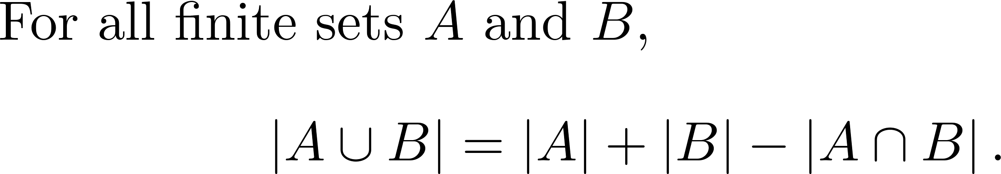
The case for two sets
Why?

Slide 4
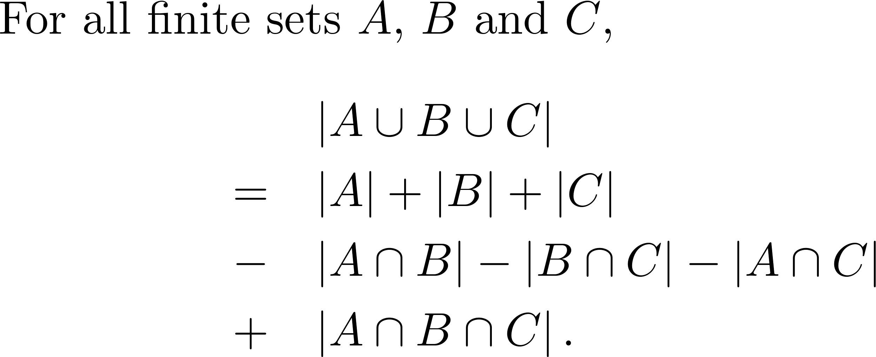
The case for three sets

Slide 5
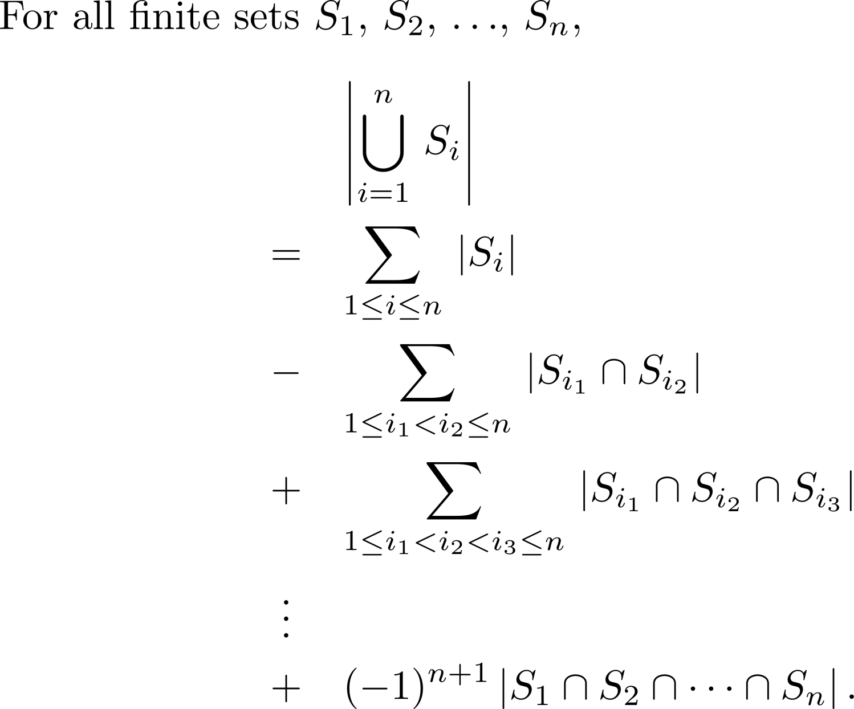
The inclusion–exclusion principle

Slide 6
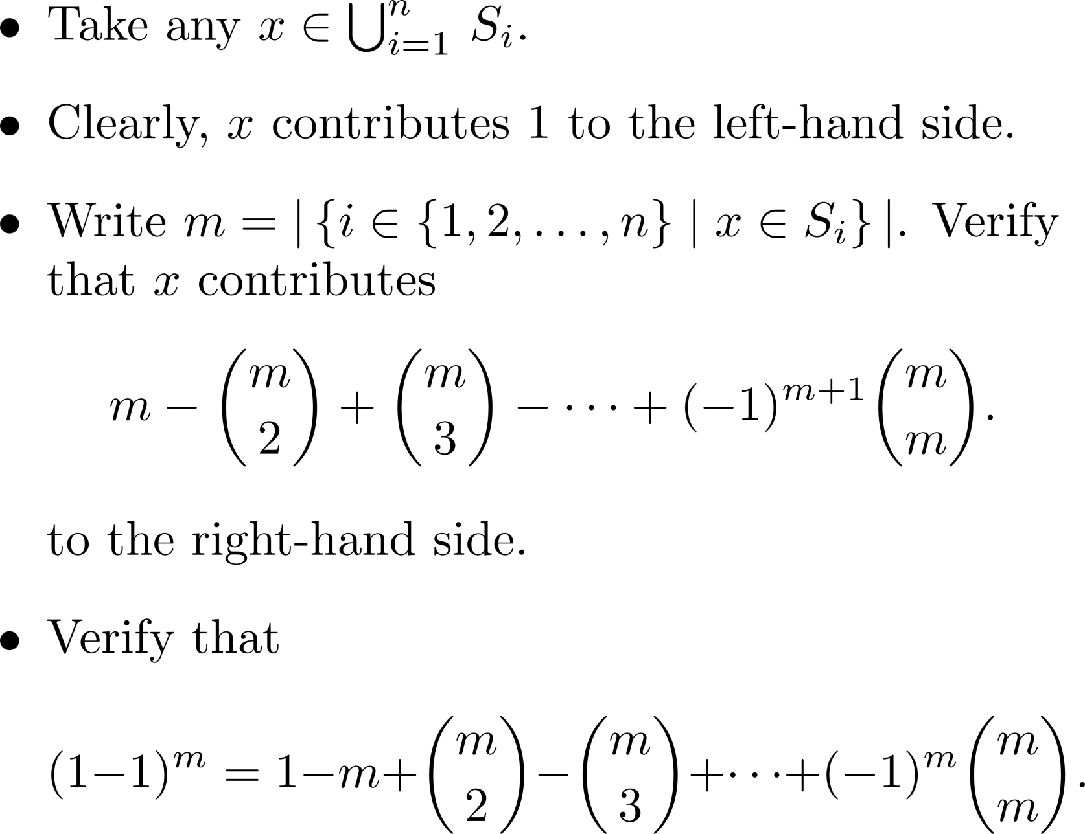
Proof

Slide 7
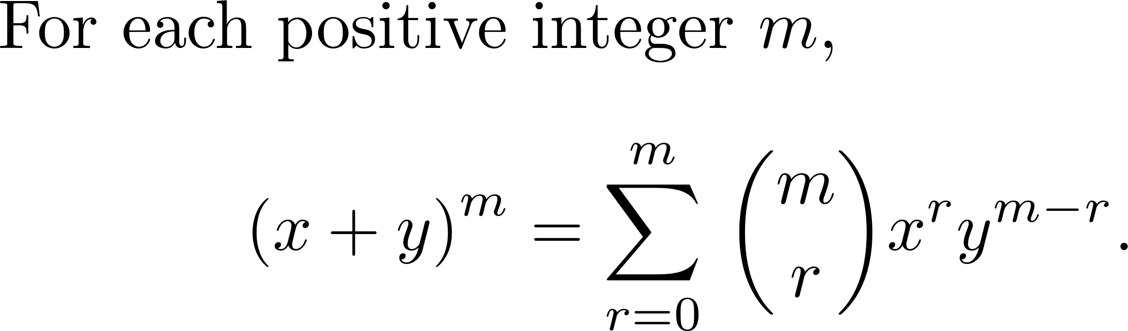

The binomial expansion
Exercise: Prove this!

Slide 8

Exercise
State the inclusion–exclusion principle for four sets

Slide 9
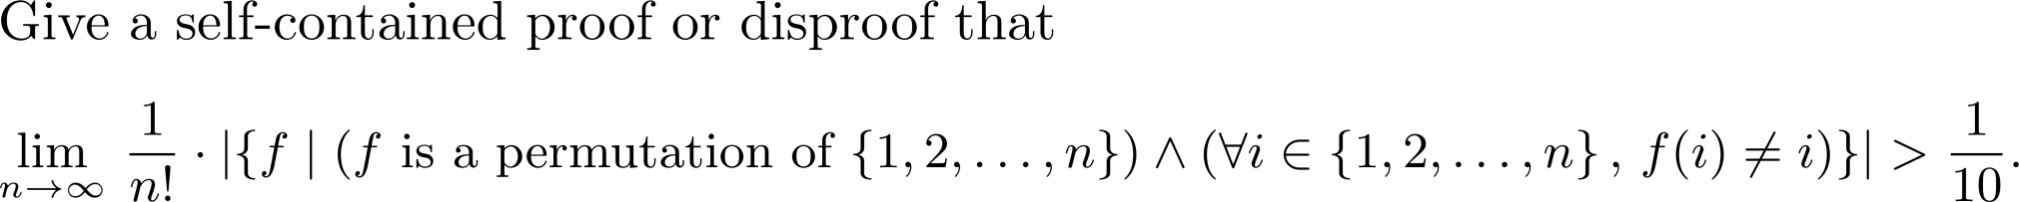
Exercise

Slide 10
Comments and questions?

